Slide 1


Used Cars Price Analysis

Slide 2

Agenda
1. Objective of the Project
2. Web Scrapping
3. Data Cleaning
4. EDA
5. Scenarios
6. Conclusion

Slide 3
Objective of the Project
Understanding and Analyzing the used cars prices all over India
Suggesting the best used cars based on model year, fuel type, kms_driven, location and budget to the customers.

Slide 4
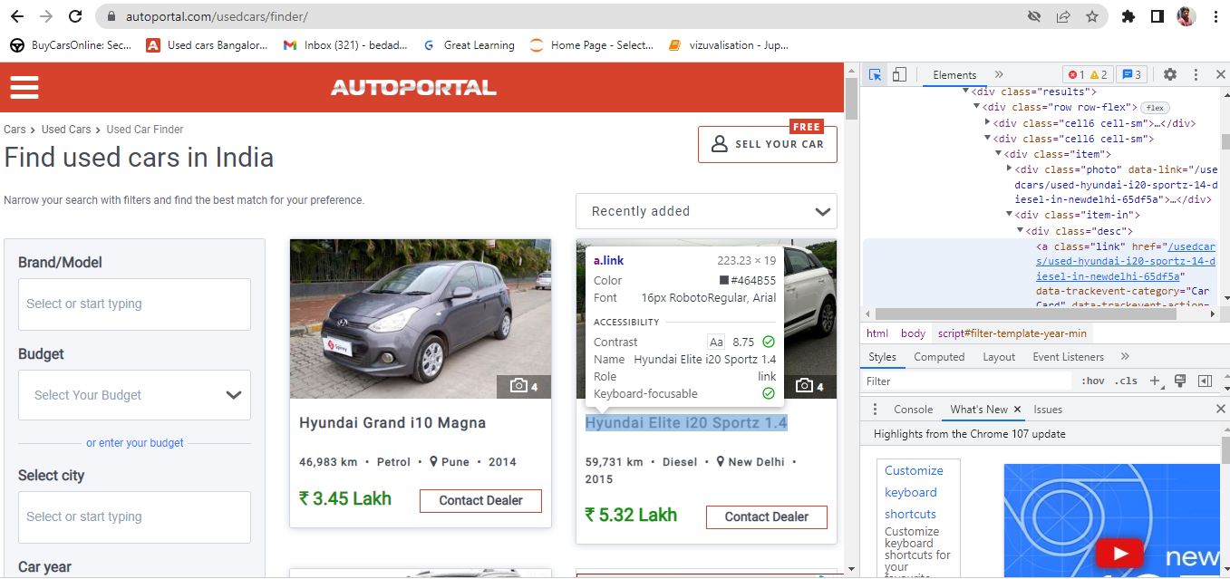
Web Scrapping :

Slide 5
Libraries used to scarp the data from html file:
Beautiful Soup
Requests
Libraries used to Clean the Data:
Pandas
Numpy
Regex
Libraries used to Represent the Data in a Graphical way:
Matplotlib
Seaborn

Slide 6
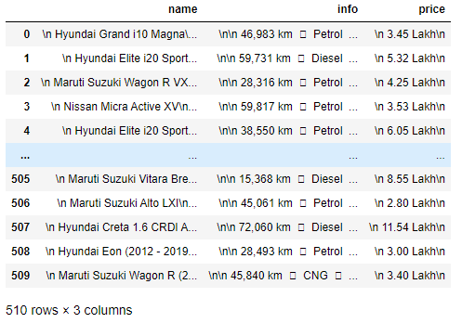
Raw Data

Slide 7
Cleaning Steps
Replacing the Unwanted Characters by using replace method.
Extracting the required text from a string using regex.
Finding and imputing the empty cells.
Identifying and imputing the null values.
Removing the outliers.
Changing the Data Types of Columns.
Renaming the columns.

Slide 8
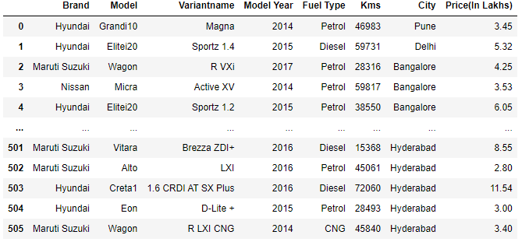
Cleaned Data:

Slide 9
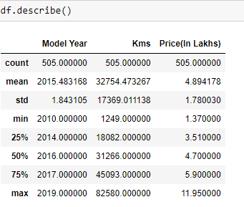
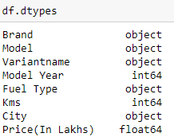
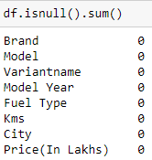

Summary of Cleaned Data :

Slide 10
EDA(Exploratory Data Analysis) :
1) Univariate Analysis : It is a form of analysis that only involves a single variable.
a) Numeric
b) Categoric
2) Bivariate Analysis : Analysis with only two variables
a) Numeric vs Numeric
b) Categoric vs Categoric
c) Categoric vs Numeric
3) Multivariate Analysis : Analysis with more than two variables.

Slide 11
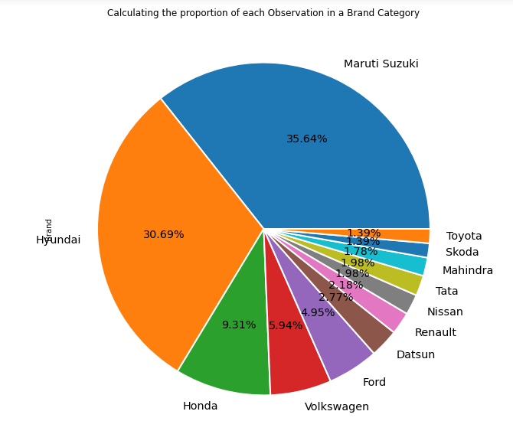
Univariate Analysis
First Place goes to Maruti Suzuki and last place goes to Skoda and Toyota Brands in accordance to the proportion that occupied in the chart.

Slide 12
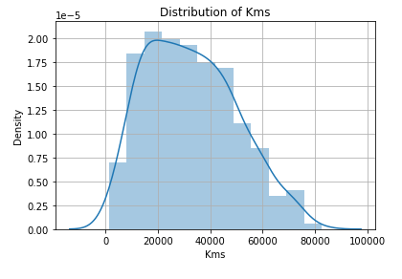
Distribution of KMS
Mainly we use distplot to examine how the data is distributed.
Here we found that data is distributed normally.

Slide 13
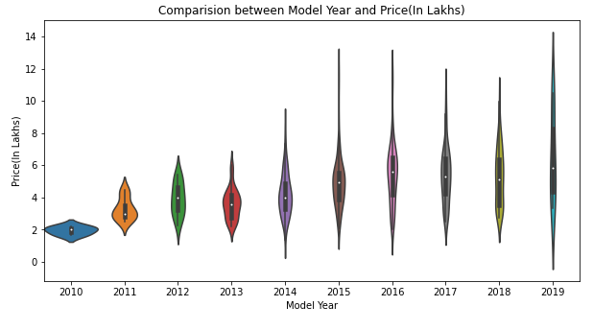
Bivariate Analysis :
Model Year vs Price
Seeing the above plot we got to know that in 2019 we find the cars from min to max price

Slide 14
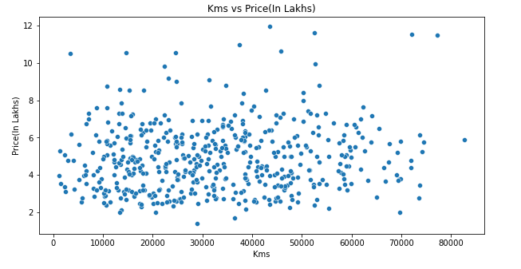
Kms vs Price
In the above scatter plot we cannot define relation between the variables.

Slide 15
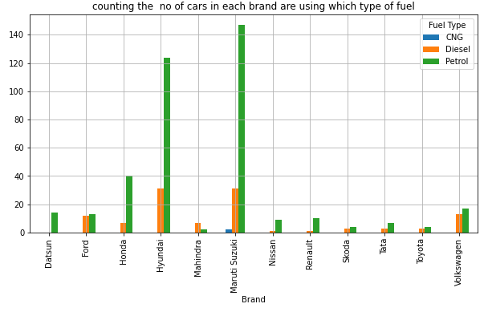
Brand vs Fuel Type
Maruti Suzuki bags the first place when we count the no of cars using Petrol, Diesel and CNG as Fuel.

Slide 16
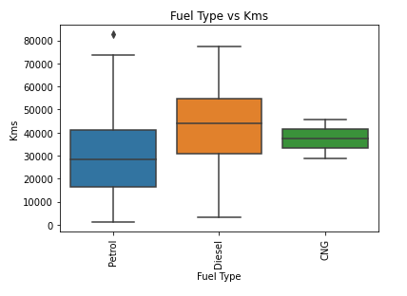
Fuel Type vs Kms
By Analyzing the plot we can conclude that Diesel Cars gives more milage compare to others.

Slide 17
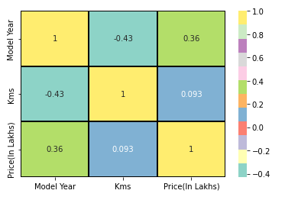
Multivariate Analysis
Here we can observe a negative correlation(-0.43) for kms vs Price
A positive correlation(0.36) is identified for price vs Model Year

Slide 18
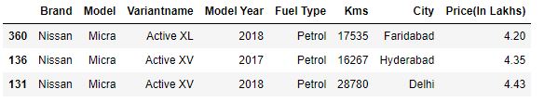
Scenario 1 :
Brand is Nissan, Model Year > 2014,Fuel Type is Petrol and Price < 5 Lakhs

Slide 19
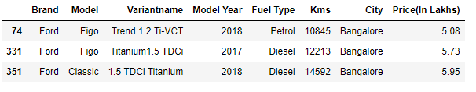
Scenario 2 :
Brand is Ford, Model Year > 2016,Kms driven < 20k,City is Bangalore and Price < 10 Lakhs

Slide 20
Conclusion :
By analyzing the data I have found that as the Model Year increases the price of car also goes up.
Most of the Used Cars are Maruti Suzuki and Hyundai brands.
Kms is indirectly proportional to Model year.
Most of the cars are Petrol Type.
Skoda brand cars are expensive.
We can find Maruti Suzuki cars of every Model Year.

